Slide 1
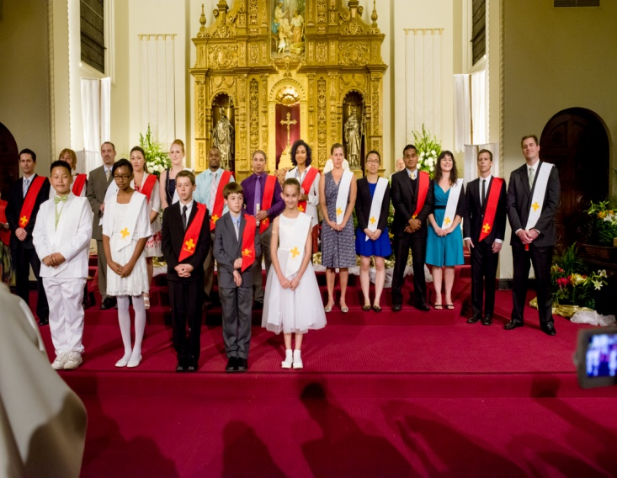
The Laity as Priests, Prophets and Servant Leaders

Slide 2
Paul tells us..
For through faith you are all children of God, in Christ Jesus. For all of you who were baptized into Christ have clothed yourselves with Christ. There is neither Jew nor Greek, there is neither slave nor free person, there is not male or female; for you are all one in Christ Jesus. (Gal 26-28)

Slide 3
Paul also tells us…
For as in one body we have many parts, and all the parts do not have the same function, so we, though many, are one body in Christ and individually parts of one another. Since we have gifts that differ according to the grace given to us, let us exercise them:

Slide 4
if prophecy, in proportion to the faith; if ministry, in ministering; if one is a teacher, in teaching; if one exhorts, in exhortation; if one contributes, in generosity; if one is over others, with diligence; if one does acts of mercy, with cheerfulness. (Romans 12: 4-8)

Slide 6
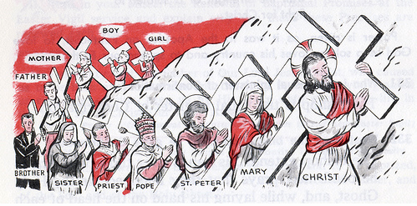

Slide 7
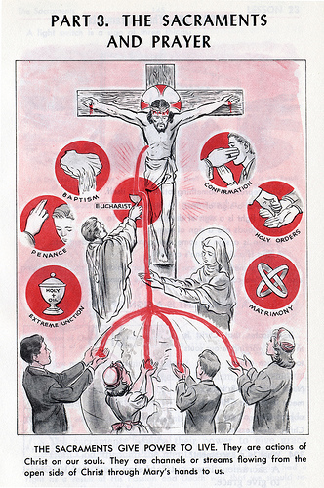

Slide 9
In 1906, Pope Pius X wrote:
It follows that the Church is essentially an unequal society, that is, a society comprising two categories of persons, the Pastors and the flock, those who occupy a rank in the different degrees of the hierarchy and the multitude of the faithful.

Slide 10
Pope Pius X, contin.
So distinct are these categories that with the pastoral body only rests the necessary right and authority for promoting the end of the society and directing all its members towards that end; the one duty of the multitude is to allow themselves to be led, and, like a docile flock, to follow the Pastors .
(Vehementer Nos, #8)

Slide 11
The Pray, Pay and Obey Model

Slide 12
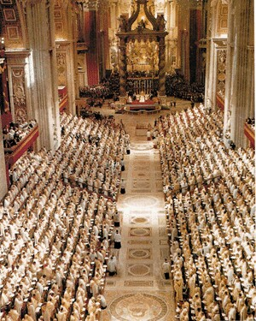
Vatican II says….
Notes:
Laity often defined in the negative: can’t consecrate, not ordained, cannot preach, they are not obliged to be celibate. Vatican II brought back to life the positive contributions of the laity, rooted in our earliest Christian traditions and collective memory the Church as it came into being in the first few centuries.

Slide 13
Lumen Gentium
Dogmatic Constitution on the Church (11/21/64)
We are all the People of God (laity, religious, clergy)
By virtue of the gifts given at Baptism and Confirmation, we each share in the church’s saving mission
Living members who share in building up the Church
Each one of us is called to holiness
Notes:
Paragraphs 30-38 of Lumen Gentium particularly address the laity as members of the church. They are part of the Body of Christ, with Christ as its head.
In these paragraphs we hear phrases such as:
In paragraph 32 we hear the following, “In the church not everyone walks along the same path, yet all are called to holiness and have obtained an equal privilege of faith through the justice of God. The paragraph goes on to say that “all the faithful enjoy a true equality with regard to the dignity and the activity which they share in the building up of the body of Christ.”
We are reminded of unity yet our diversity of gifts:
Thus in their diversity all bear witness to the wonderful unity in the Body of Christ. This very diversity of graces, ministries and works gathers the children of God into one, because "all these things are the work of one and the same Spirit".
So—we have a gift, we have a call, we have a role.

Slide 14
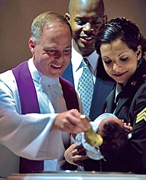
The Laity: defined
“…they are in their own way made sharers in the priestly, prophetical, and kingly functions of Christ; and they carry out for their own part the mission of the whole Christian people in the Church and in the world.” para. 31
Notes:
Paragraph 31 opens with: “The term laity is here understood to mean all the faithful except those in holy orders and those in the state of religious life specially approved by the Church. These faithful are by baptism made one body with Christ and are constituted among the People of God; they are in their own way made sharers in the priestly, prophetical, and kingly functions of Christ; and they carry out for their own part the mission of the whole Christian people in the Church and in the world.”

Slide 15
…building up the Church
“all the faithful enjoy a true equality with regard to the dignity and the activity which they share in the building up of the body of Christ.”
para. 32
Notes:
Sometimes we think of building up the Church in terms of building campaigns, or recruiting volunteers. St. Francis fell into that trap, as well. If you recall, he thought God was calling him to put stone upon stone and rebuild the chapel at San Damiano. Instead, what God had in mind was being part of building up the people of God.
Lumen Gentium echoes this charge and reminds the laity that this responsibility is not restricted to priests, deacons, or consecrated religious for “all the faithful enjoy a true equality with regard to the dignity and the activity which they share in the building up of the body of Christ.”
And how we tackle this is going to be different for each and every one of us. We are reminded of unity yet our diversity of gifts:
Thus in their diversity all bear witness to the wonderful unity in the Body of Christ. This very diversity of graces, ministries and works gathers the children of God into one, because "all these things are the work of one and the same Spirit".

Slide 16
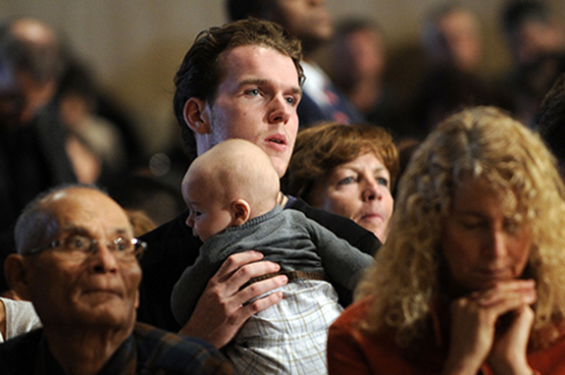
Called to holiness
“In the church not everyone walks along the same path, yet all are called to holiness and have obtained an equal privilege of faith through the justice of God.” para. 32
Notes:
we are all called to holiness—sometimes we think of holiness as “for someone who is a priest, a nun, takes a vow of poverty, or someone who does nothing but pray all day long, or does a lot of charity work.” Holiness is lifelong commitment to seek out a personal relationship with God. This is a universal call…not for us to leave our families and our day jobs but to be faithful followers of Jesus where we are—in our homes, our schools, our community and our workplaces.

Slide 17
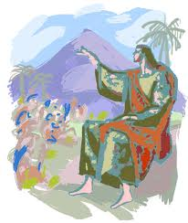
A role distinctive to the laity
To make the church present and fruitful in those places and circumstances where they have received, are at once the witnesses and the living instruments of the mission of the church itself, “according to the measure of Christ’s gift.”
para. 33
Notes:
The role normally associated with the lay faithful is oriented outward. In our homes, our workplace, schools, our kids’ sports fields, bars, restaurants, and other social gatherings, we have the unique opportunity to be witnesses and living instruments of the love and mercy of Jesus.

Slide 18
The role of the laity in our parish communities
Their activity within the church communities is so necessary that without it the apostolate of the pastors will frequently be unable to obtain its full effect.
The laity should develop the habit of working in the parish in close cooperation with their priests…according to their abilities the laity ought to cooperate in all the apostolic and missionary enterprises of their ecclesial family.
(Apostolicam Actuositatem, #10)

Slide 19
How is this lived out at Holy Family?

Slide 20
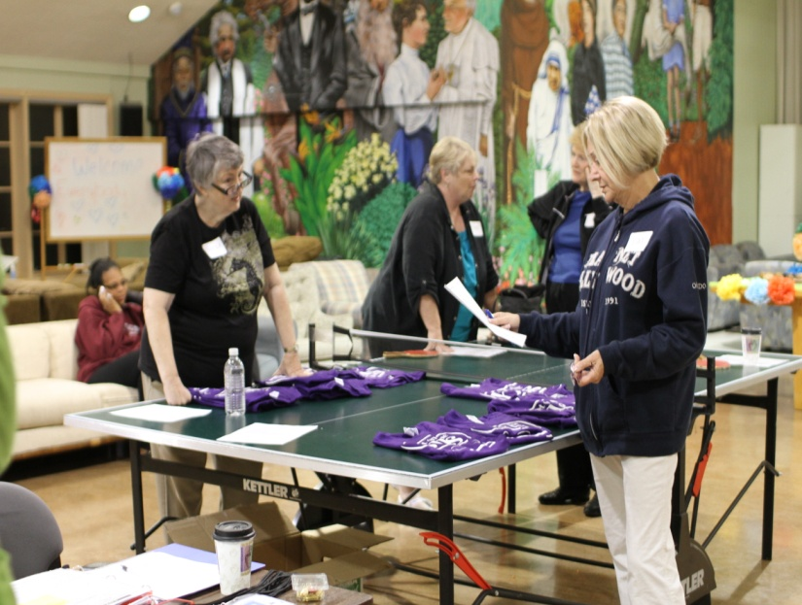
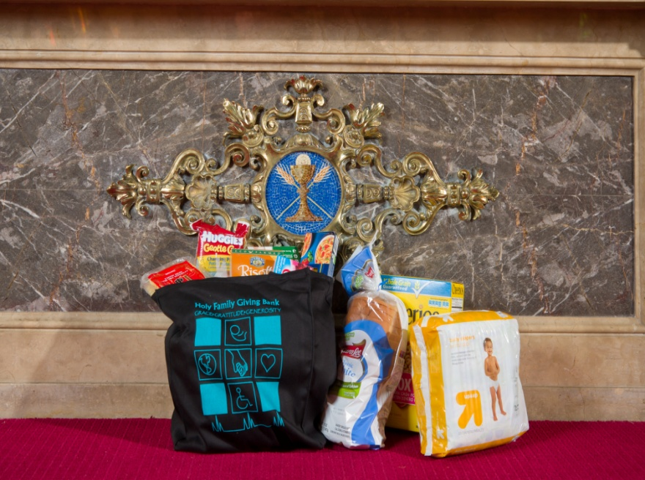
Grace, Gratitude and Generosity

Slide 21
Living Your Gifts

